Slide 1

Topic 1 – Excel Homework
Katherine Shamai

Slide 2
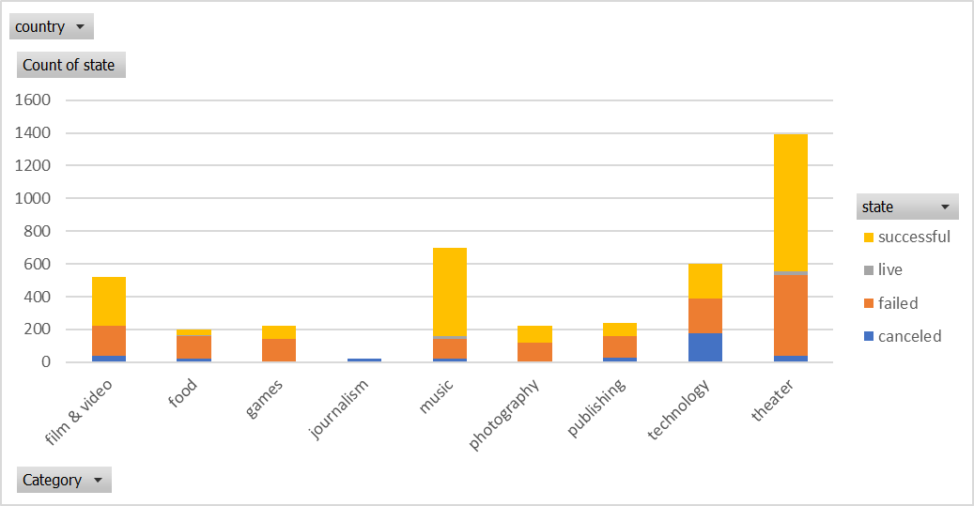
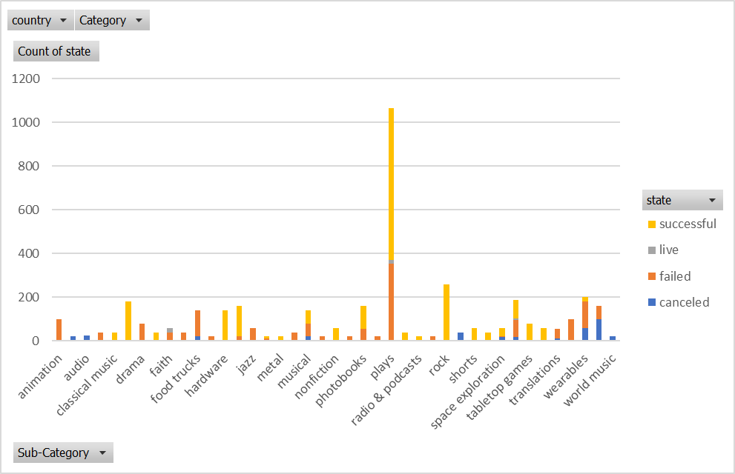
Given the provided data, what are three conclusions we can draw about Kickstarter campaigns?
Insight #1 (Refer Purple Circle)
Theatre projects, especially plays, have the highest success rate of being funded; potentially implying the popularity of the genre and its appeal to backers.
Insight #2 (Refer Blue Circle)
Journalism projects have the lowest successful rate; potentially implying a lack of interest in the proposed projects.
Insight #3 (Refer Green Circle)
The ratio of successfully backed projects within a category may not be reflective of the ratio of success across its sub-categories. For example, the music category has a fairly high level of projects being successfully funded; however, there are a number of sub-categories, e.g. world music, and jazz, which are poorly backed or canceled.

Slide 3
What are some limitations of this dataset?
Limitation #1
The value of the projects are in different currencies. To enable effective comparison, we would need to create a new field, and convert the funding values to a common currency to compare the level of funding projects have attracted.
Limitation #2
The data does not provide information on how project owners engaged with backers, e.g. number of updates. There is a column to say whether the projects were spotlighted but the data does not capture whether the project owners were proactive to promote or engage with backers to maximising backing funding. This data would be helpful to draw correlation between passive project owners and the level of funding those projects attract compared to project owners are proactive.
Limitation #3
The data does not specify whether the projects have a minimum pledge requirement, and whether the backers selected pledges which attract a perk. This would help identify whether perks attract more backers or whether the funding attracted are more like donations in nature. This would be helpful to understanding what may draw a backer to a project.

Slide 4
What are some other possible tables and/or graphs that we could create?
Comparisons based on a common currency
Create a common currency value table to enable comparison between projects from a funding perspective
Using the common currency value table, compare whether projects from different jurisdictions attract different levels of average levels of funding per backer
Time based analysis
Create a column with campaign duration to analyse how long a campaign was active for
Using the campaign duration column, create a scatterplot to identify any correlation between campaign duration and whether it is successful
Create a similar analysis for failed projects
Correlation between launch dates, key dates (e.g. public holidays), and whether a project is successful. This may help identify whether launching a project during certain times of year would increase their likelihood of success.
Create a similar analysis for failed projects
Promotion analysis
Correlation between whether a project is spotlighted and their outcomes, i.e. whether they are successfully funded or failed

